Slide 1
MAVERICK BANK
TRAINEE NAME: SRUTHI RAMESH TRAINER NAME: JAVEED MOHAMMED HUSNUDDIN

Slide 2
About Maverick Bank
The Maverick Bank is a Banking and Financial System is a comprehensive application designed to manage the financial transactions and accounts of customers in a banking. This system caters to both individual and business customers, offering services such as account management, funds transfer, loans, investments, and financial reporting.
The system includes role-based dashboards for customers, bank employees, and administrators.

Slide 3
Key Features
JWT-based login & authentication
Role-based dashboards: Customer,
Bank Employee, Administrator
Customer registration and profile update.
Profile view and update for customers.
Open new bank account (select type, branch, balance).
View all customer accounts with delete option (for employees).
Transaction listing by account number.
Loan application with status: PENDING / APPROVED / REJECTED
Loan review & status update by bank employee.
Form validations using Angular template-driven forms and reactive forms.
Routing
Responsive UI using Bootstrap and Flexbox.
Component-based structure for easy maintenance.

Slide 4
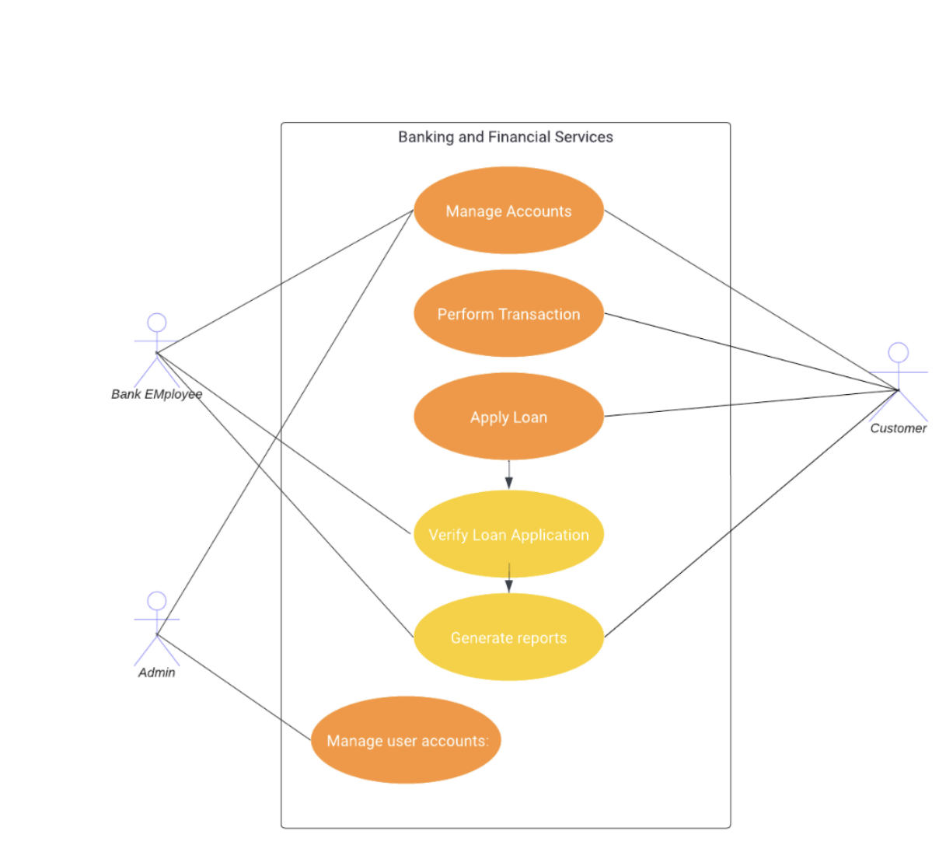
USE CASE DIAGRAM:

Slide 5
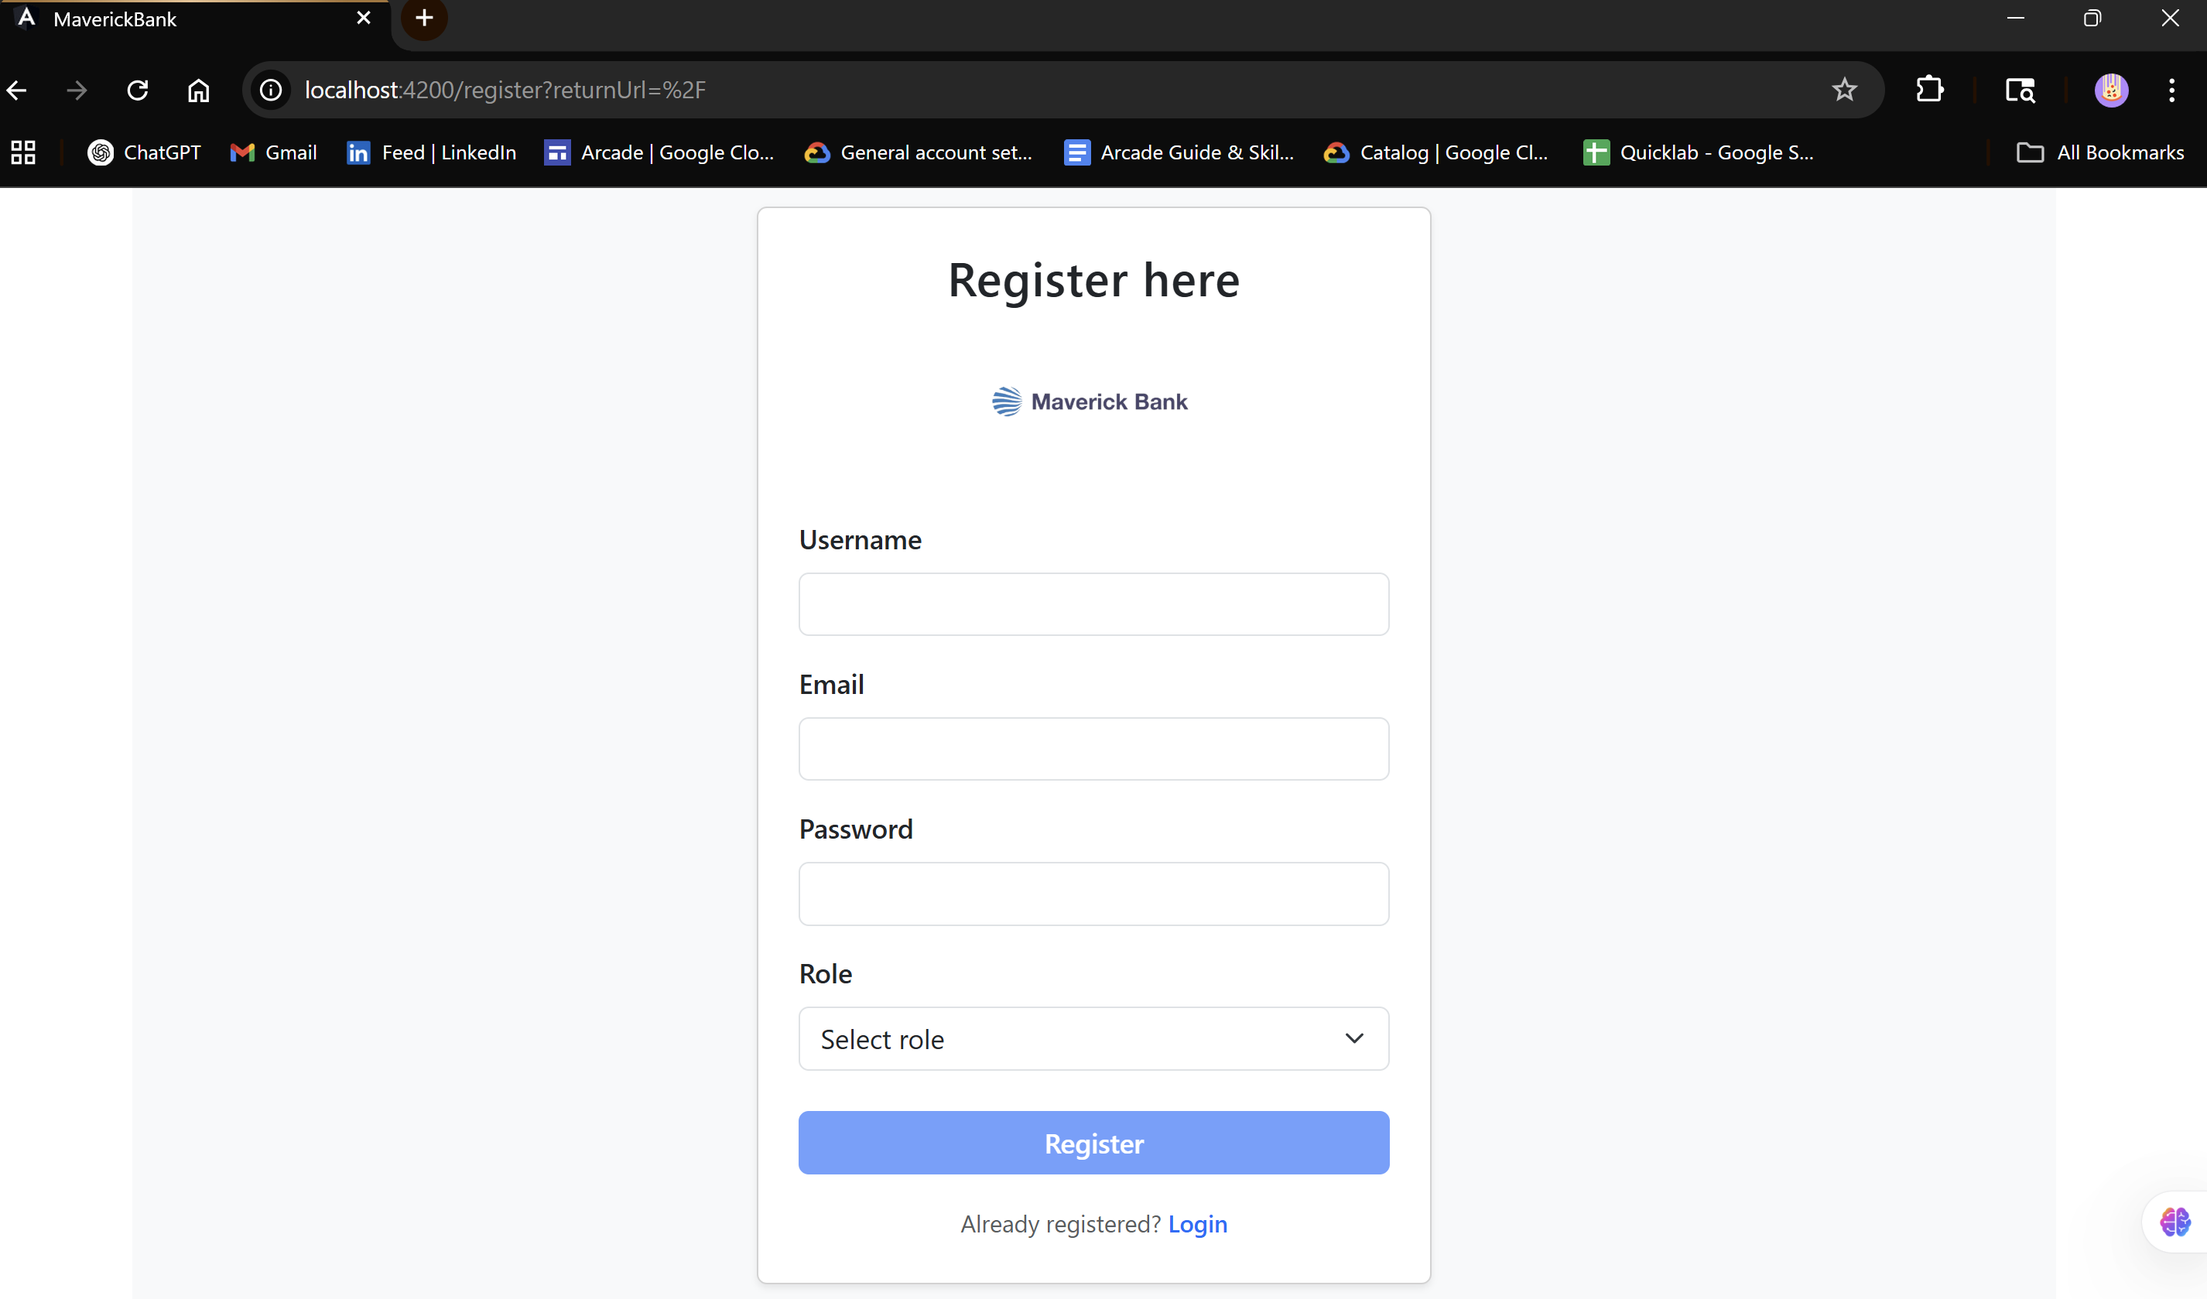
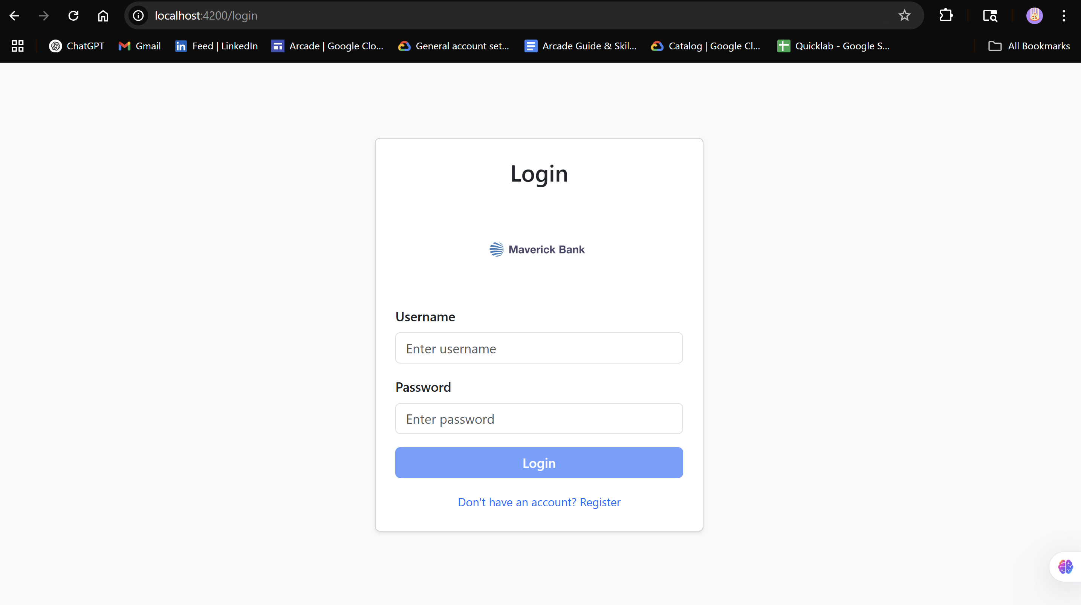
SCREENSHOTS
REGISTRATION PAGE:
LOGIN PAGE:

Slide 6
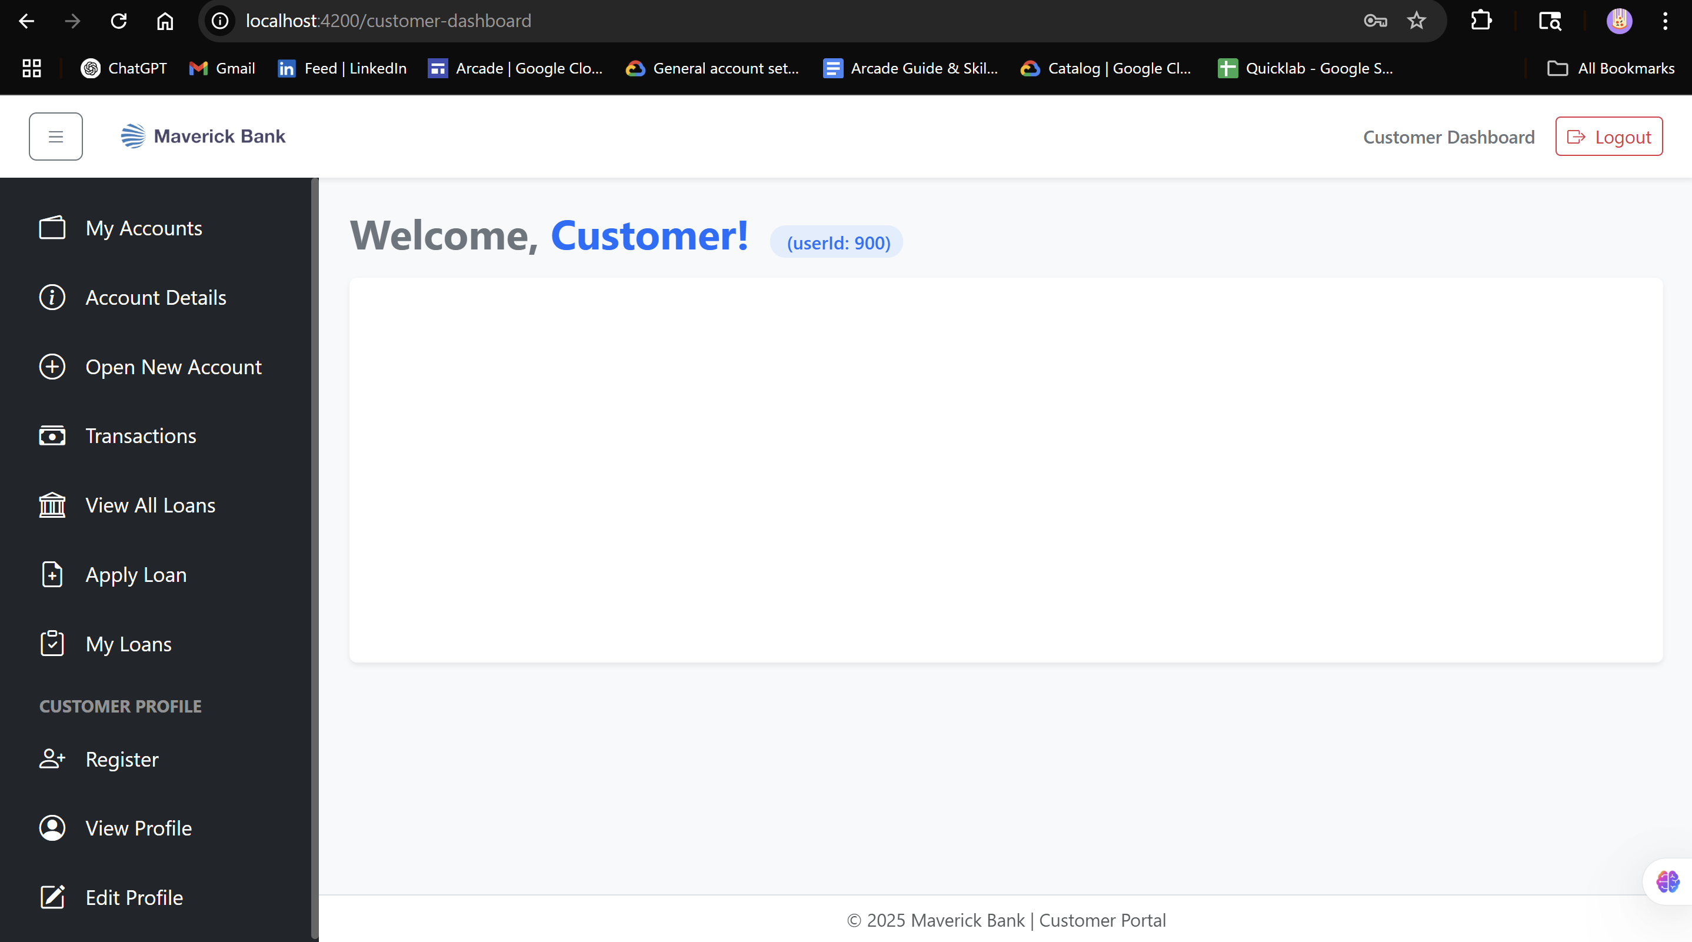
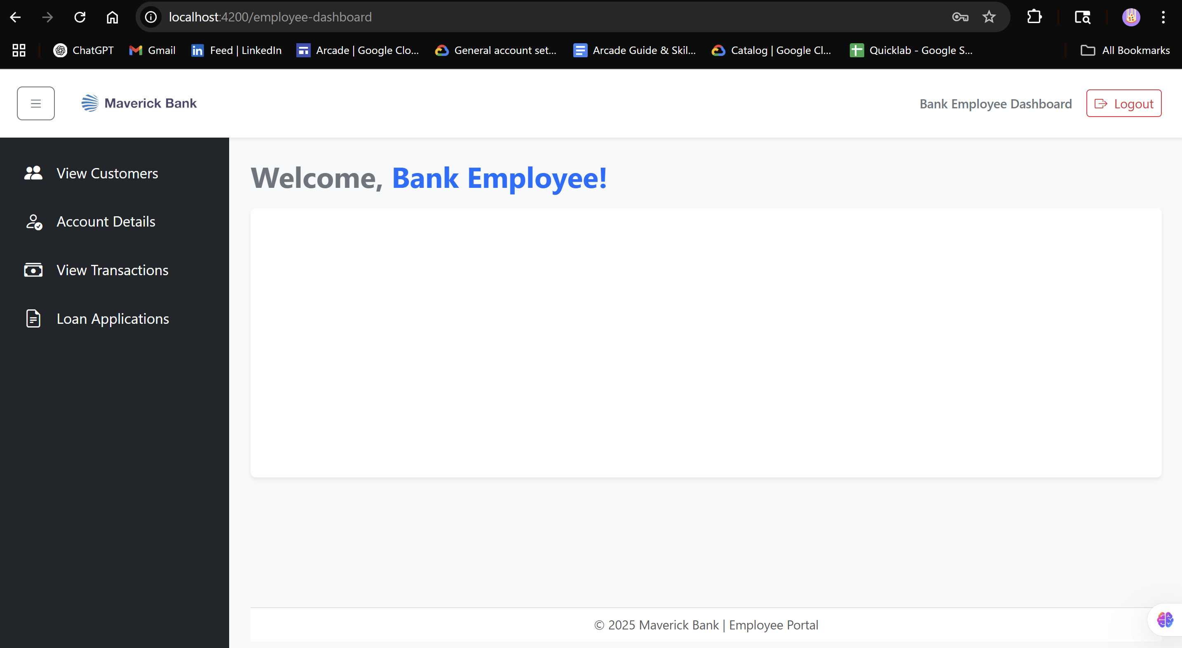
SCREENSHOTS
CUSTOMER DASHBOARD PAGE:
EMPLOYEE DASHBOARD PAGE:

Slide 7
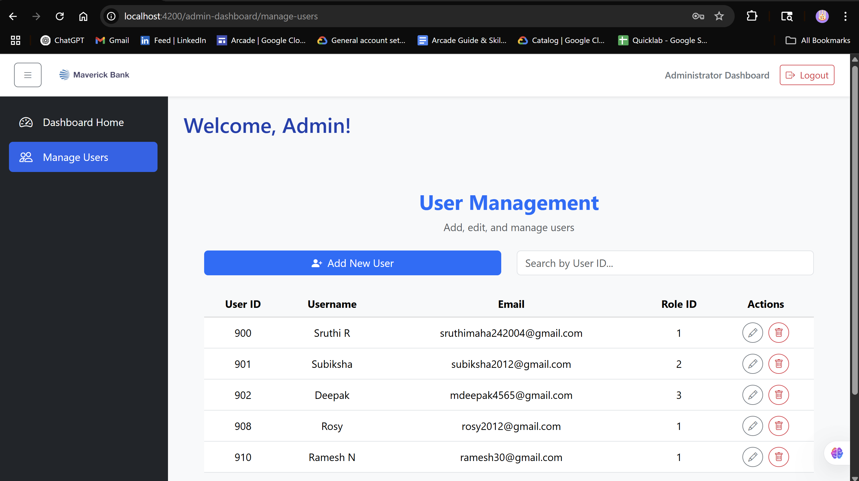
SCREENSHOTS
ADMIN DASHBOARD PAGE:

Slide 8
Technologies Used
Frontend: Angular, Bootstrap
Backend: Spring Boot, Spring Security, JWT
Database: MySQL
Tools: Docker Desktop, Swagger, Postman, Git, GitHub, VS Code, STS

Slide 9
Conclusion
Maverick Bank demonstrates full-stack development skills using modern frameworks and practices.
It is designed to be scalable, secure, and modular, making it suitable for real-world banking workflows.

Slide 10
Thank you
SRUTHI RAMESH
sruthimaha242004@gmail.com
https://github.com/Sruthi-Ram/Maverick_Bank_Project

